Slide 1
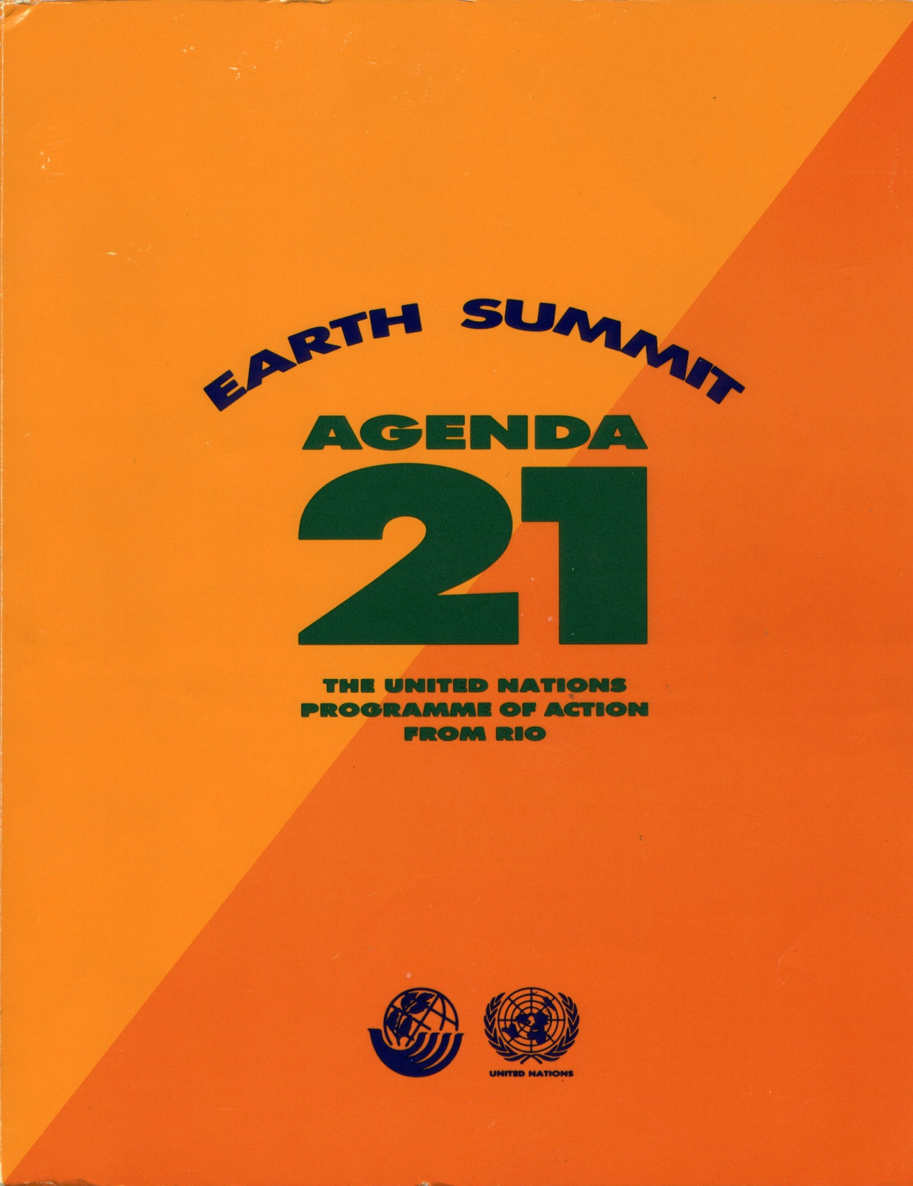
Agenda 21
Chapter 1 Preamble
Section I. Social and Economic Dimensions Chapter 2 International Cooperation for Sustainable Development Chapter 3 Combating Poverty Chapter 4 Changing Consumption Patterns Chapter 5 Demographic Dynamics & Sustainability Chapter 6 Human Health Chapter 7 Human Settlements Chapter 8 Decision Making
Section II. Conservation and Management of Resources for Development Chapter 9 Protection of the Atmosphere Chapter 10 Land Resources Chapter 11 Deforestation Chapter 12 Desertification & Drought Chapter 13 Sustainable Mountain Development Chapter 14 Sustainable Agriculture & Rural Development Chapter 15 Conservation of Biodiversity Chapter 16 Biotechnology Chapter 17 Protection of the Oceans Chapter 18 Freshwater Resources Chapter 19 Toxic Chemicals - Management Chapter 20 Hazardous Wastes - Management Chapter 21 Solid Wastes - Management Chapter 22 Radioactive Wastes - Management
Section III. Strengthening The Role Of Major Groups Chapter 23 Preamble Major Groups Chapter 24 Women Chapter 25 Children & Youth Chapter 26 Indigenous People Chapter 27 Non-Governmental Organizations Chapter 28 Local Authorities Chapter 29 Trade Unions Chapter 30 Business & Industry Chapter 31 Scientific & Technological Community Chapter 32 Role of Farmers
Section IV. Means of Implementation Chapter 33 Financial Resources Chapter 34 Technology Transfer Chapter 35 Science for Sustainable Development Chapter 36 Education, Public Awareness & Training Chapter 37 Capacity Building in Developing Countries Chapter 38 International Institutions Chapter 39 International Legal Instruments Chapter 40 Information for Decision-making
Other Rio Agreements Framework Convention on Climate Change Convention on Biological Diversity Forest Principles The NGO Alternative Treaties
International Union for the Conservation of Nature

Slide 2
IUCN—What is it?
Purpose
"...promote alternative models for sustainable communities and lifestyles, based in ecospiritual practices and principles...to accelerate our transition to a just and sustainable future....
Humanity must undergo a radical change in its attitudes, values, and behavior....
In response to this situation, a new global ethics is taking form, and it is finding expression in international law."
IUCN’s Ethics Working Group’s publication, Earth Ethics, 1996
http://www.crle.org/pub_eeindex_spr96.asp

Slide 3
The Unholy Trinity
Federal Agencies
IUCN
EPA, USFWS, NPS, USFS;
ICLEI, Sierra Club, Nature Conservancy, Nat. Wild. Fed., Nat. Audubon, NRDC, EDF;
UNEP, UNDP, UNESCO
IUCN
EPA, USFWS, NPS, USFS;
ICLEI, Sierra Club, Nature Conservancy, Nat. Wild. Fed., Nat. Audubon, NRDC, EDF;
Implement Eco-Spiritual Strategy Locally
World Resources Institute
IUCN
EPA, USFWS, NPS, USFS;
IUCN
UN
Environmental Groups
World Wildlife
Fund

Slide 4
What does sustainable development really mean?
IUCN Endgame Definition:
Sustainable by definition, means not only indefinitely prolonged, but nourishing, as the earth is nourishing to life and the
self-actualizing of persons and communities. The word development need not be restricted to economic activity,
but can mean the evolution, unfolding growth and fulfillment of any and all aspects of life.
Steven Rockefeller, Spirit and Nature (Boston: Beacon, 1992), page 8.

Slide 5
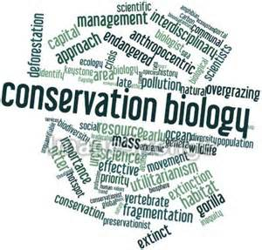
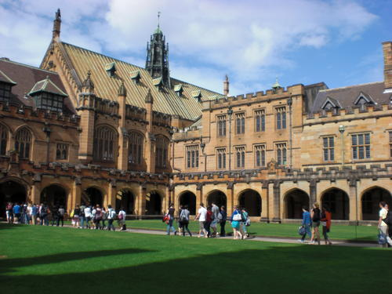
NGO Foundations Fund University
Conservation Biology Programs
1970s
Late 1970s & 1980s
Journal of Conservation Biology Issue 1, 1987
“The society is a response...to the biological diversity crisis that will reach a crescendo in the first half of the 21st century. We assume implicitly that...the worst biological disaster in the last 65 million years can be averted.... We assume implicitly that environmental wounds inflicted by ignorant humans and destructive technologies can be treated by wiser humans and by wholesome technologies.”
5

Slide 6
March 30 BLM summit on ecosystem management identified the objective/purpose of ecosystem management:
"All ecosystem management activities should consider human beings as a biological resource..."
6

Slide 7
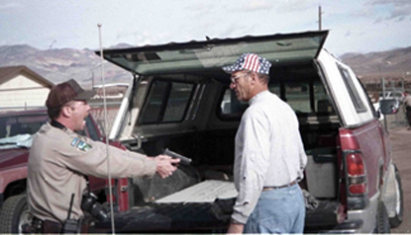
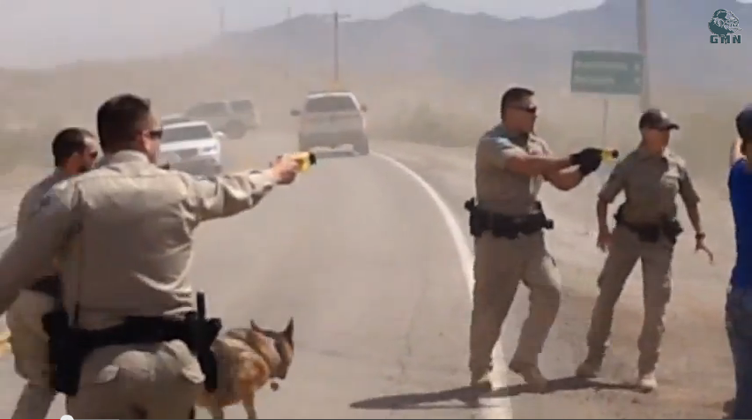
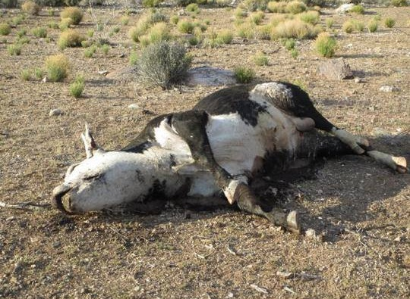
7

Slide 8
IUCN to the EPA, Interior Department, etc.
"Natural resource and environmental agencies... should...develop a joint strategy to help the United States fulfill its existing international obligations (e.g. Convention on Biological Diversity, Agenda 21). . . .
The executive branch should direct federal agencies to evaluate national policies...in light of international policies and obligations, and to amend national policies to achieve international objectives."
Source: EPA Internal Working Document, August 6, 1993, pp 9.

Slide 9
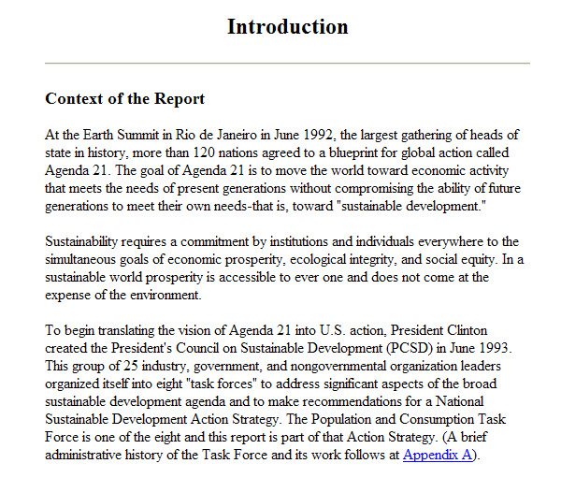
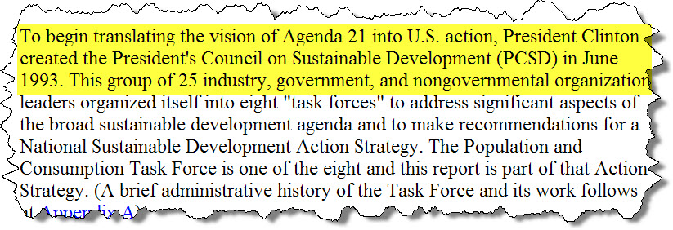

Slide 10
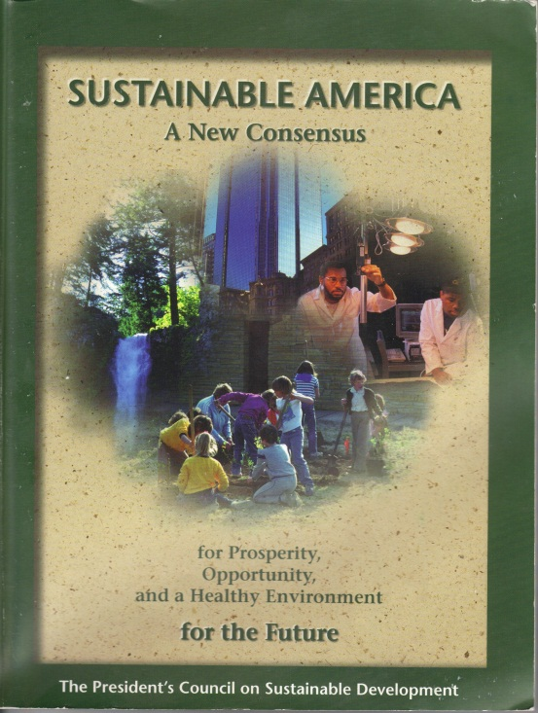
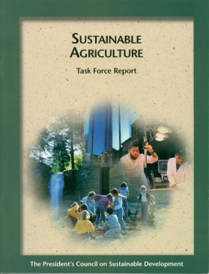
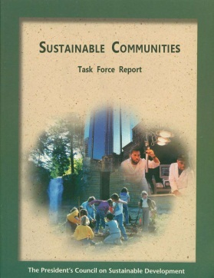
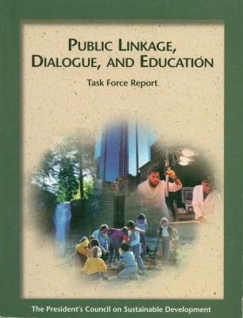
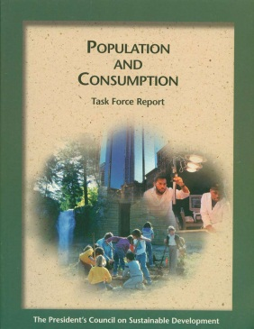
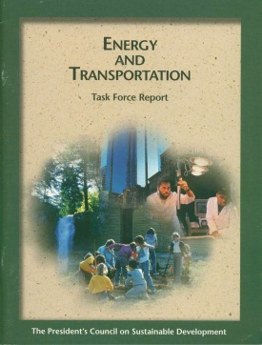
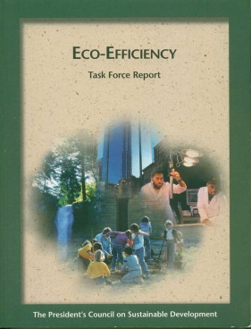
http://clinton2.nara.gov/PCSD/
President’s Council on Sustainable Development
1992
1993
1996
Every Federal Agency’s New Mission
U.S. Conf. of Mayors & National Assoc. Counties
Grants to State and Local Governments

Slide 11
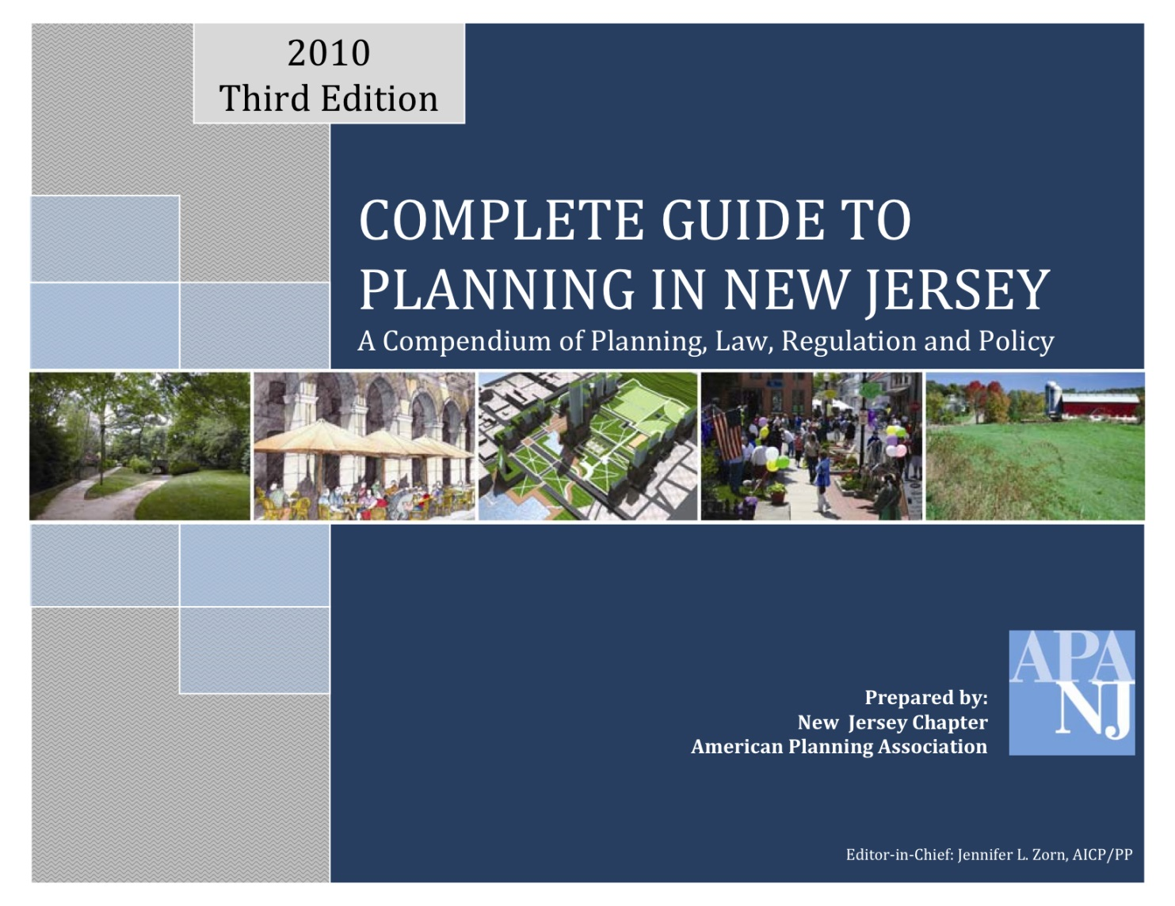
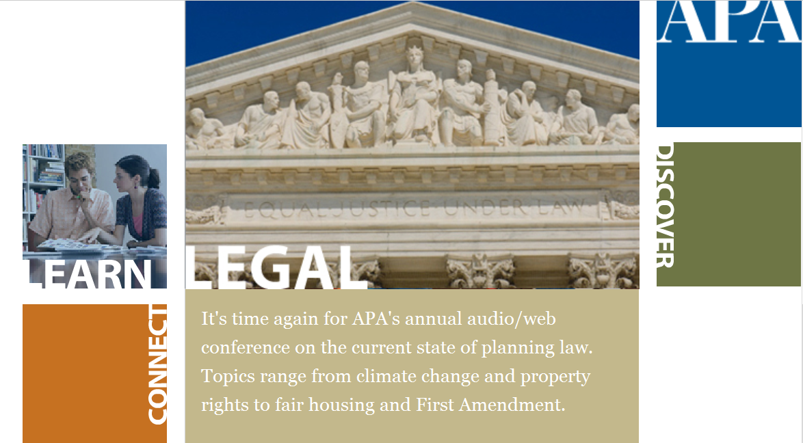
NGOs Promoting Smart Growth
Works Closely with:
Nature Conservancy
Land for Public Trust
Sierra Club
NRDC
Other environmental groups
Other planning groups
ICLEI
American Planning Association (APA)

Slide 12
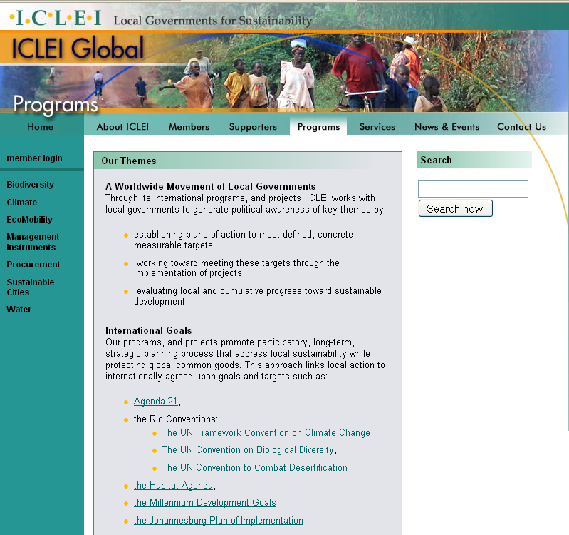
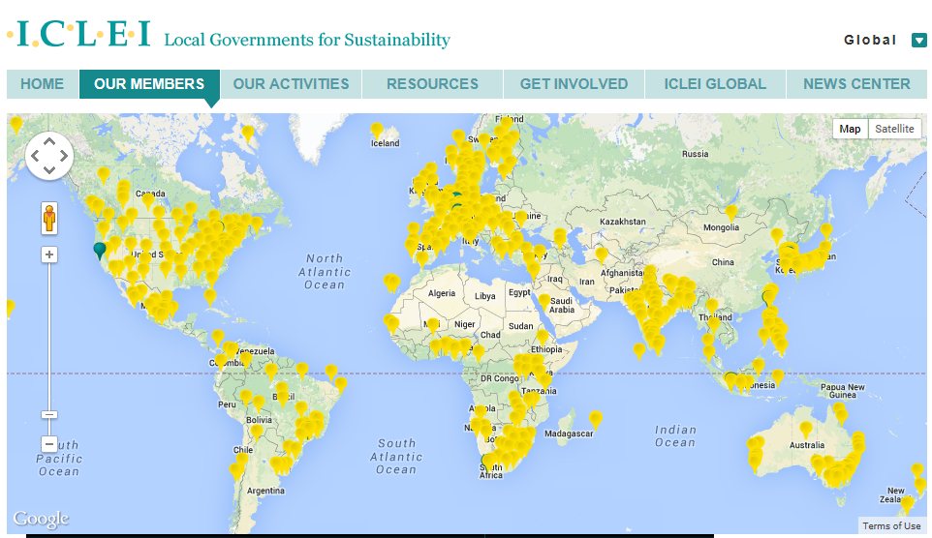
NGOs Promoting Smart Growth
American Planning Association (APA)
International Council for Local Environmental Initiatives (ICLEI)
Now called Local Governments for Sustainability
Works Closely with:
United Nations
Nature Conservancy
Land for Public Trust
Sierra Club
NRDC
American Planning Assoc.
Other environmental groups
Other planning groups

